Slide 1
Sequential User Behavior Modeling in CTR Prediction
Jiarui Qin
May. 21, 2020

Slide 2
Table of Contents
First generation of sequential CTR models
Utilizing sequential user behaviors
DIN, DIEN
Second generation of sequential CTR models
Using much longer sequences
System + algorithm, co-design
HPMN, UIC (MIMN)
Another view
Tackle these problems from another perspective
UBR4CTR

Slide 3
Sequential User Modeling in CTR Prediction Task
Goal: model and memorize user interests and the drifting dynamics of them
Differences from session-based recommendation
Session-based recommendation task: anonymous behavior sessions
Sequential user modeling: with all the side info of user/item/context features
Different scenarios

Slide 4
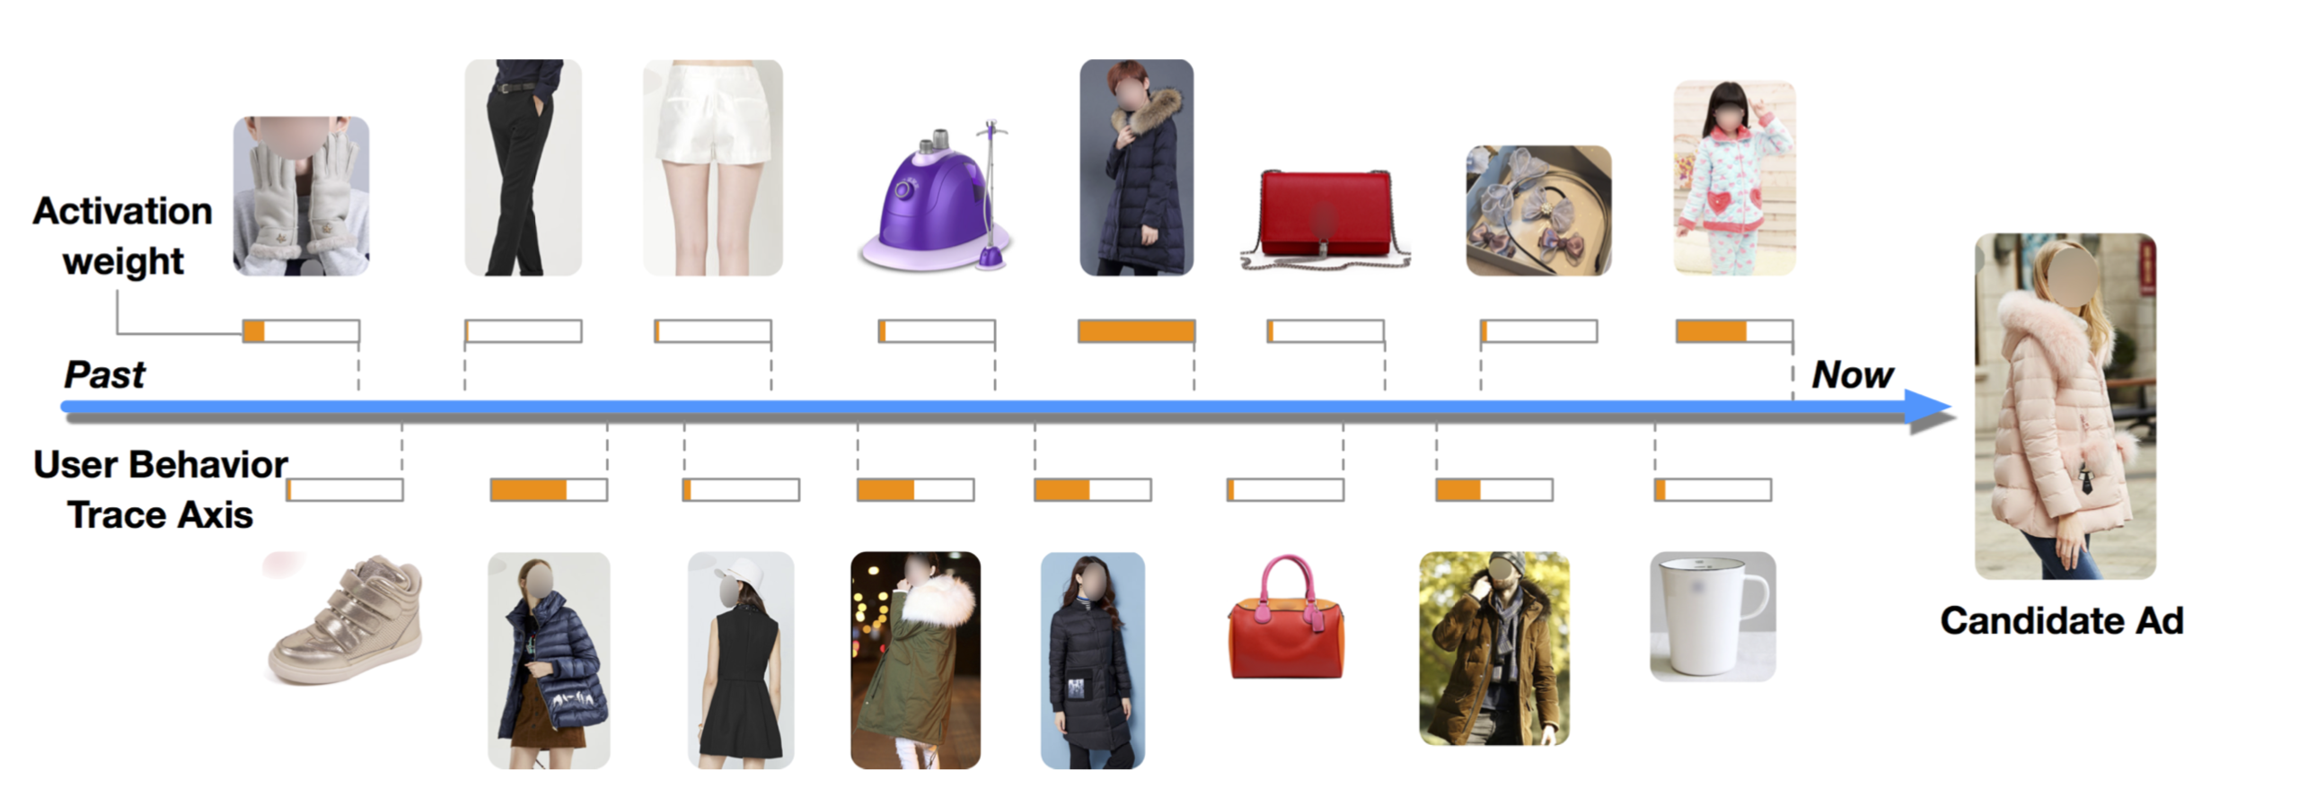
1st Generation: Deep Interest Network (DIN)
Assign proper weights to the items that the user had interacted with
G. Zhou et al. Deep Interest Network for Click-Through Rate Prediction. In KDD ’18, 2018.

Slide 5
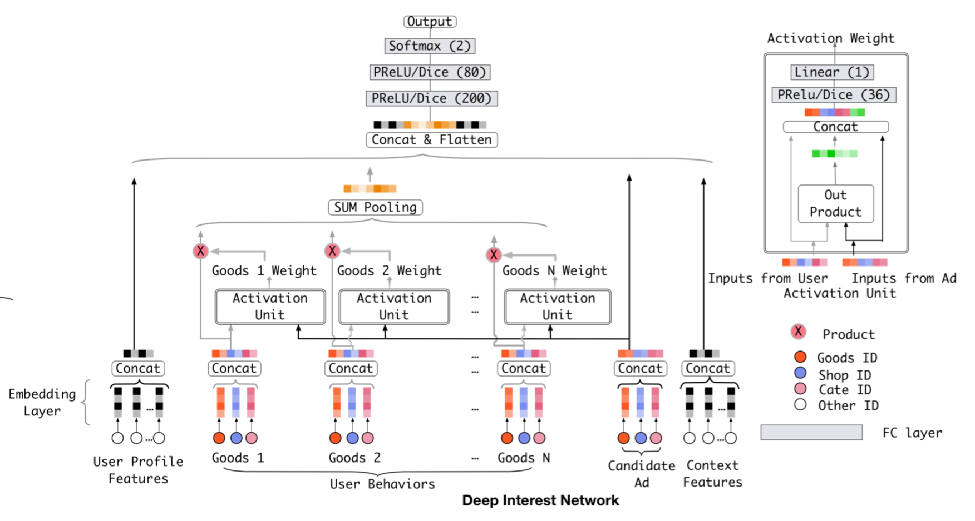
1st Generation: Deep Interest Network (DIN)
Model Architecture
用户特征
行为序列
商品/环境特征
G. Zhou et al. Deep Interest Network for Click-Through Rate Prediction. In KDD ’18, 2018.

Slide 6
1st Generation: Deep Interest Network (DIN)
Model Architecture
注意力计算
全连接层
注意力层
目标商品
G. Zhou et al. Deep Interest Network for Click-Through Rate Prediction. In KDD ’18, 2018.

Slide 7
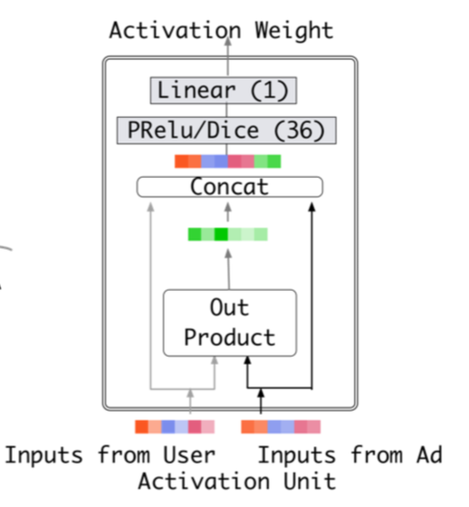
1st Generation: Deep Interest Network (DIN)
Use candidate ad as “query”, user sequential behaviors as “key/value” to calculate attention weights
Attention calculation:
$v_{U}\left(A\right)=f\left(v_{A},e_{1},e_{2},…,e_{H}\right)=\sum_{j=1}^{H}{a\left(e_{j},v_{A}\right)e_{j}=\sum_{j=1}^{H}{w_{j}e_{j}}}$
$a\left(e_{j},v_{A}\right)$:

Slide 8
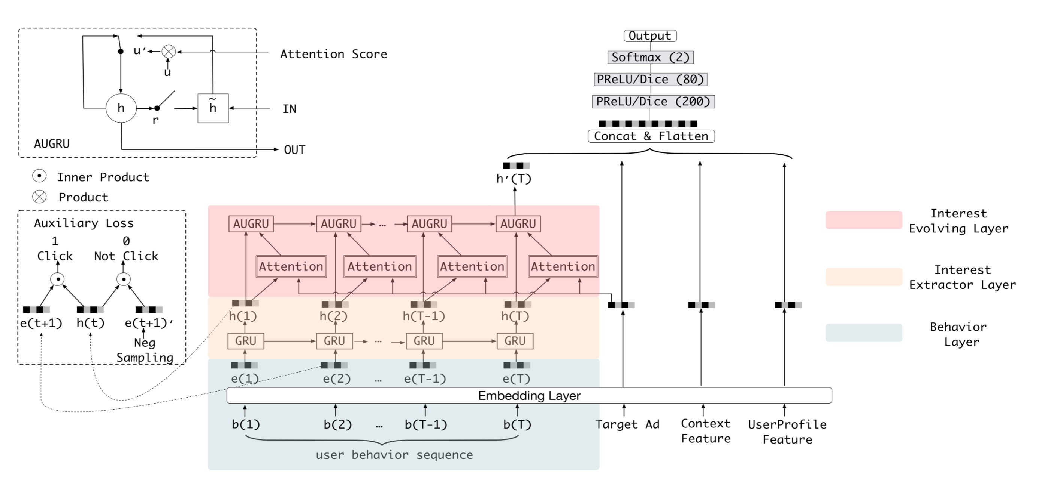
1st Generation: Deep Interest Evolution Network (DIEN)
Architecture:
行为序列
目标商品
G. Zhou et al. Deep Interest Evolution Network for Click-Through Rate Prediction . In AAAI ’19, 2019.

Slide 9
1st Generation: Deep Interest Evolution Network (DIEN)
Architecture:
AUGRU
兴趣演化层
辅助loss
兴趣抽取层
G. Zhou et al. Deep Interest Evolution Network for Click-Through Rate Prediction . In AAAI ’19, 2019.

Slide 10
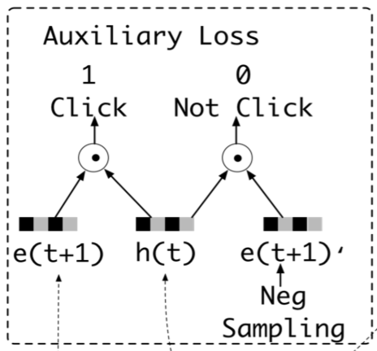
1st Generation: Deep Interest Evolution Network (DIEN)
Use GRU as interest extraction layer
Auxiliary loss
$$L_{aux}=−\frac{1}{N}(\sum_{i=1}^{N}{\sum_{t}{\log{σ(h_{t},e_{b}^{i}[t+1])}}})$$
$$+\log{(1−σ(h_{t},{\hat{e}}_{b}^{i}[t+1]))})$$
t+1时刻正例
t时刻表征
G. Zhou et al. Deep Interest Evolution Network for Click-Through Rate Prediction . In AAAI ’19, 2019.

Slide 11
1st Generation: Deep Interest Evolution Network (DIEN)
Use GRU as interest extraction layer
Auxiliary loss
$$L_{aux}=−\frac{1}{N}(\sum_{i=1}^{N}{\sum_{t}{\log{σ(h_{t},e_{b}^{i}[t+1])}}})$$
$$+\log{(1−σ(h_{t},{\hat{e}}_{b}^{i}[t+1]))})$$
t时刻表征
t+1时刻负例
G. Zhou et al. Deep Interest Evolution Network for Click-Through Rate Prediction . In AAAI ’19, 2019.

Slide 12
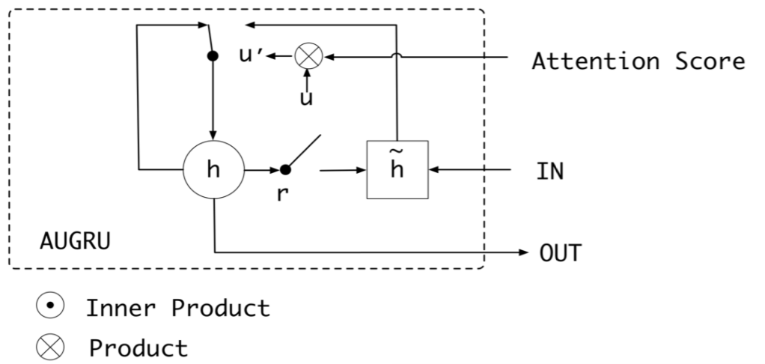
1st Generation: Deep Interest Evolution Network (DIEN)
Use AUGRU (Attention Update GRU) as interest evolution layer
G. Zhou et al. Deep Interest Evolution Network for Click-Through Rate Prediction . In AAAI ’19, 2019.

Slide 13
1st Generation: Deep Interest Evolution Network (DIEN)
Online A/B Test:
G. Zhou et al. Deep Interest Evolution Network for Click-Through Rate Prediction . In AAAI ’19, 2019.

Slide 14
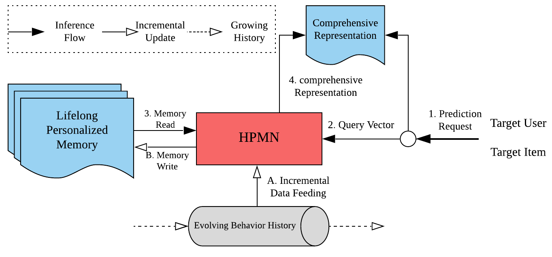
2nd Generation: Lifelong Sequential Modeling(LSM)
Framework
多层级周期记忆网络
个性化用户行为记忆
用户行为序列
K. Ren*, J. Qin*, Y. Fang* et al. Lifelong Sequential Modeling with Personalized Memorization for User Response Prediction. In SIGIR ’19, 2019.

Slide 15
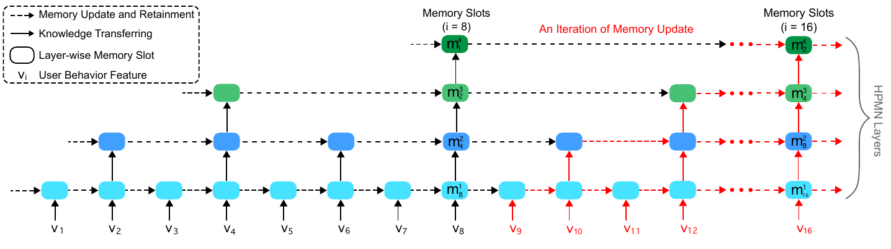
2nd Generation: Hierarchical Periodic Memory Network (HPMN)
HPMN architecture
K. Ren*, J. Qin*, Y. Fang* et al. Lifelong Sequential Modeling with Personalized Memorization for User Response Prediction. In SIGIR ’19, 2019.

Slide 16
2nd Generation: Hierarchical Periodic Memory Network (HPMN)
Memory Update:
$$m_{i}^{j}=\left\{\begin{aligned}g^{j}\left(m_{i}^{j−1},m_{i−1}^{j}\right),i mod t^{j}=0 \\ m_{i−1}^{j}, otherwise\end{aligned}\right.$$
$$z_{i}^{j}=σ\left({\overline{W}}_{z}^{j}m_{i}^{j−1}+{\overline{U}}_{z}^{j}m_{i−1}^{j}+{\overline{b}}_{z}^{j}\right)$$
$$r_{i}^{j}=σ\left({\overline{W}}_{r}^{j}m_{i}^{j−1}+{\overline{U}}_{r}^{j}m_{i−1}^{j}+{\overline{b}}_{r}^{j}\right)$$
$$m_{i}^{j}=\left(1−z_{i}^{j}\right)∘m_{i−1}^{j}+z_{i}^{j}∘tanh({\overline{W}}_{m}^{j}m_{i}^{j−1}+{\overline{U}}_{m}^{j}\left(r_{i}^{j}∘m_{i−1}^{j}\right)+{\overline{b}}_{m}^{j})$$
K. Ren*, J. Qin*, Y. Fang* et al. Lifelong Sequential Modeling with Personalized Memorization for User Response Prediction. In SIGIR ’19, 2019.

Slide 17
2nd Generation: Hierarchical Periodic Memory Network (HPMN)
Memory Reading:
Memory Covariance Regularization:
$$r=\sum_{j=1}^{D}{w^{j}∙m^{j}}$$
$$w^{j}=\frac{exp⁡(e^{j})}{\sum_{k=1}^{D}{exp⁡(e^{k})}},where{ e}^{j}=E\left(m^{j},v\right)$$
$$E\left(m^{j},v\right)=MLP\left(m^{j},v\right)$$
$$C=\frac{1}{p}(M−\overline{M})(M−\overline{M})^{T}, where M=[m^{1}, …,m^{D}]^{T}$$
K. Ren*, J. Qin*, Y. Fang* et al. Lifelong Sequential Modeling with Personalized Memorization for User Response Prediction. In SIGIR ’19, 2019.

Slide 18
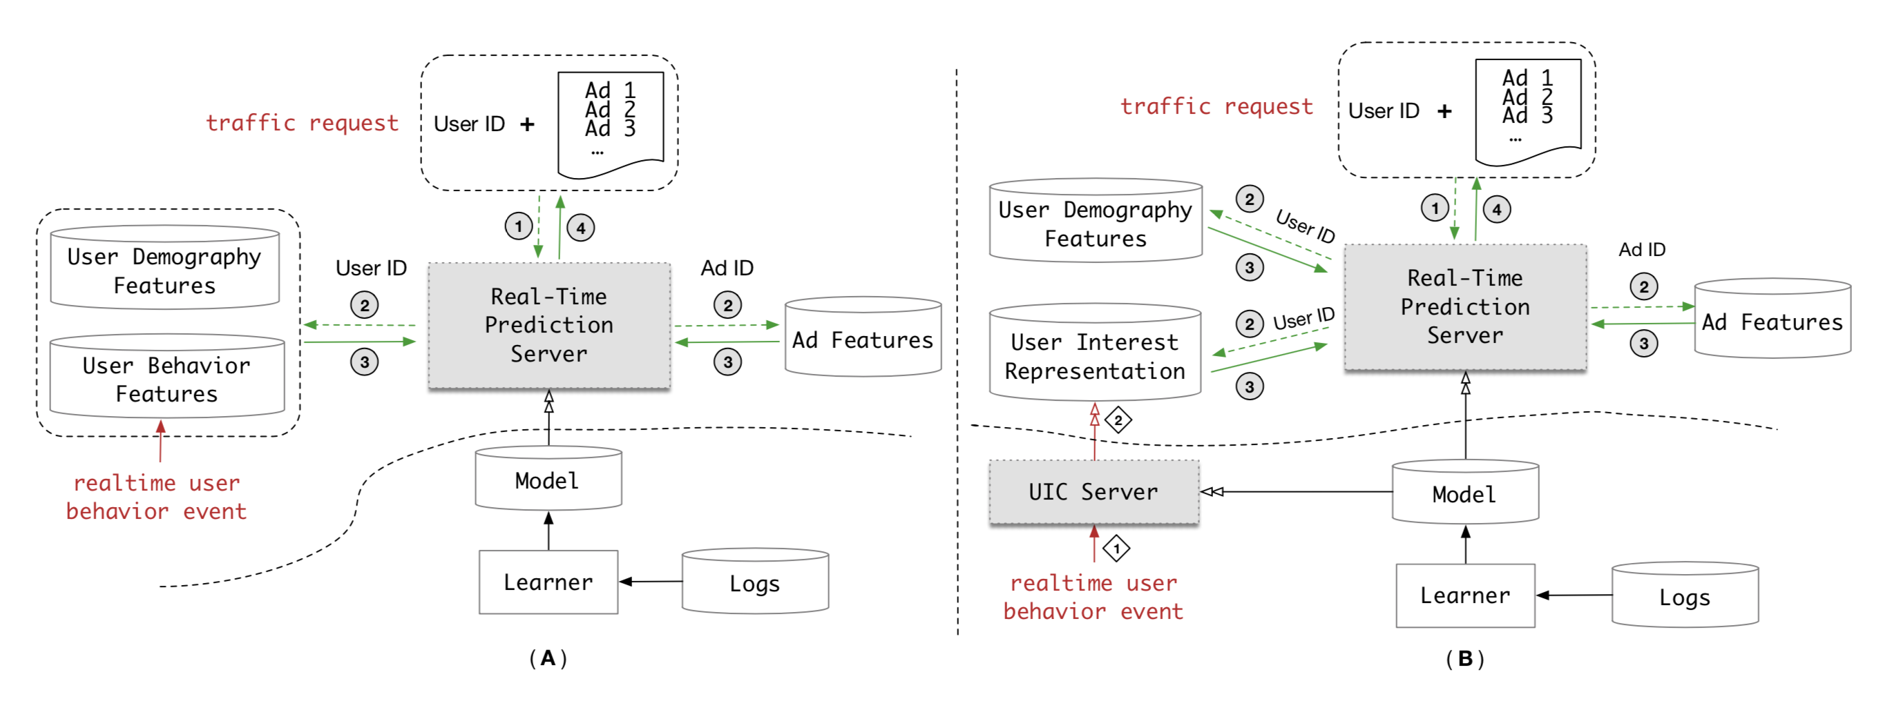
2nd Generation: User Interest Center (UIC)
Real time CTR prediction system
Q. Pi et al. Practice on Long Sequential User Behavior Modeling for Click-Through Rate Prediction. In KDD ’19, 2019.

Slide 19
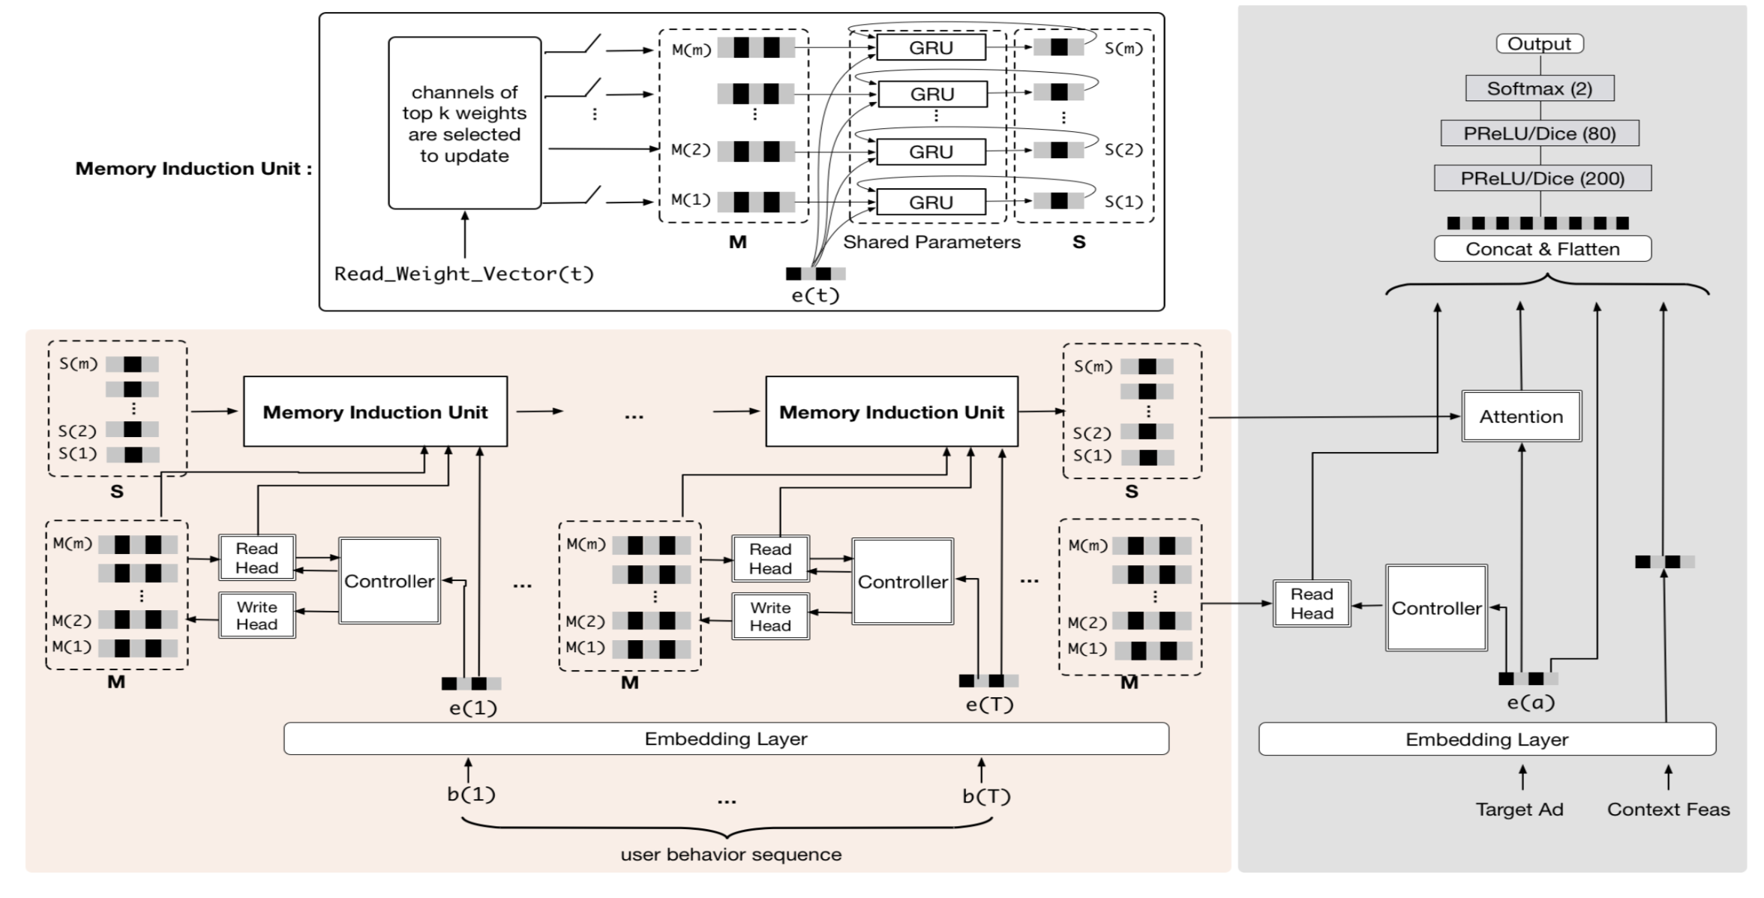
2nd Generation: Multi-Channel User Interest Memory Network (MIMN)
NTM-based architecture
Q. Pi et al. Practice on Long Sequential User Behavior Modeling for Click-Through Rate Prediction. In KDD ’19, 2019.

Slide 20
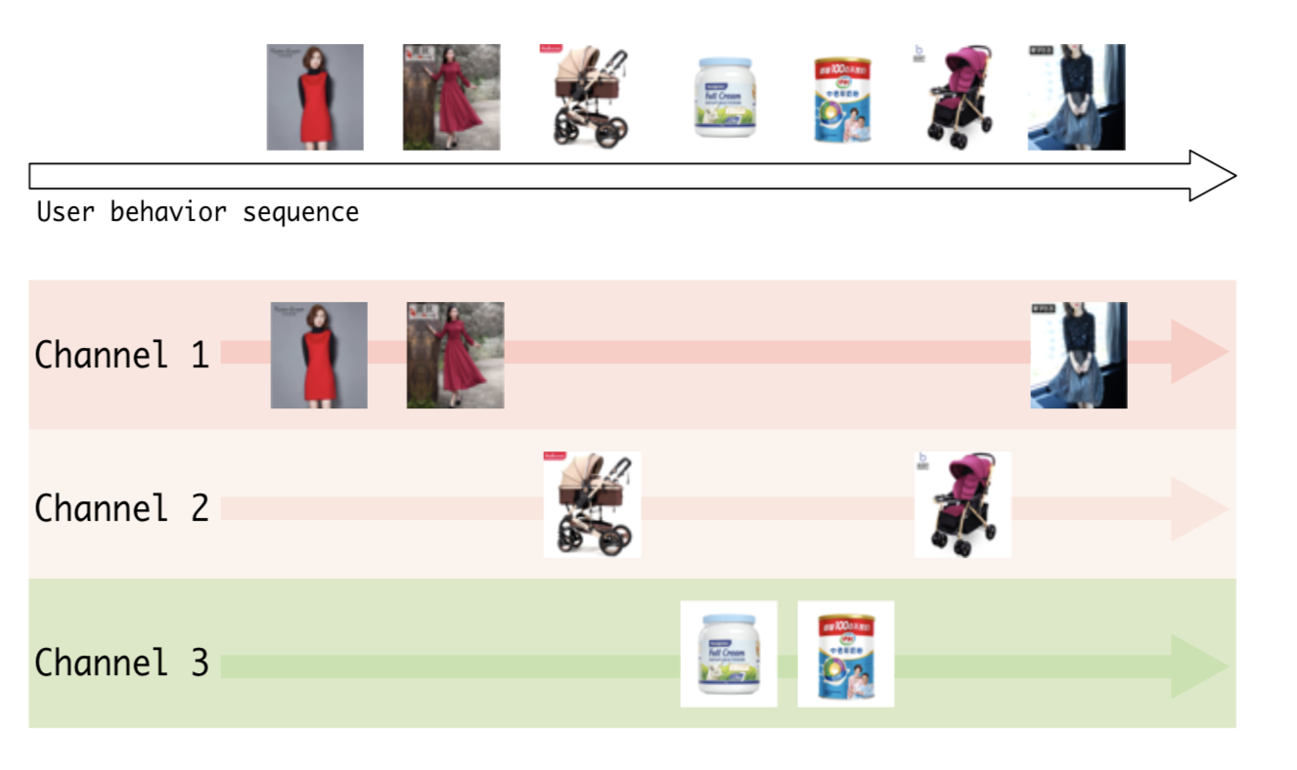
2nd Generation: Multi-Channel User Interest Memory Network (MIMN)
Expected goal
Q. Pi et al. Practice on Long Sequential User Behavior Modeling for Click-Through Rate Prediction. In KDD ’19, 2019.

Slide 21
Another Way: User Behavior Retrieval
Limitations of current sequential CTR framework
Uses the most recent N behaviors, if N is large
Heavy burden on system overhead (latency + storage), DIEN etc
Longer sequences have a lot of noise
Each prediction pair uses exactly the same recent N behaviors, the pattern may be not embeded in the recent N behaviors
Instead of designing more complex model, we turn to the data perspective
For each prediction, retrieve the most useful N behaviors (N is not large) from all the user’s log
Use search engine technique
J. Qin et al. User Behavior Retrieval for Click-Through Rate Prediction. In SIGIR ’20, 2020.

Slide 22
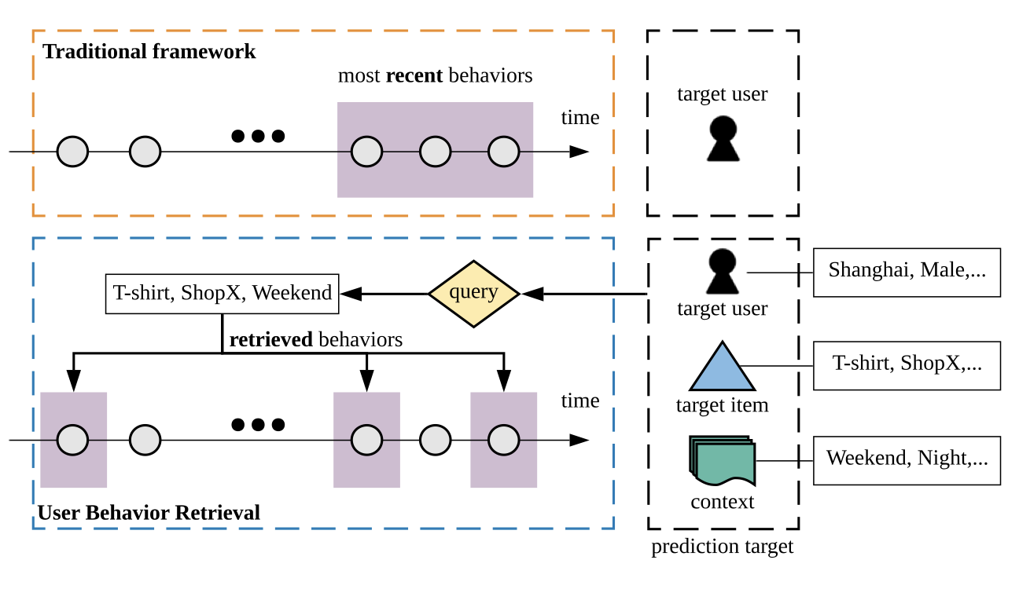
User Behavior Retrieval for CTR Prediction
Differences from original framework:
J. Qin et al. User Behavior Retrieval for Click-Through Rate Prediction. In SIGIR ’20, 2020.

Slide 23
User Behavior Retrieval for CTR Prediction
Framework:
J. Qin et al. User Behavior Retrieval for Click-Through Rate Prediction. In SIGIR ’20, 2020.

Slide 24
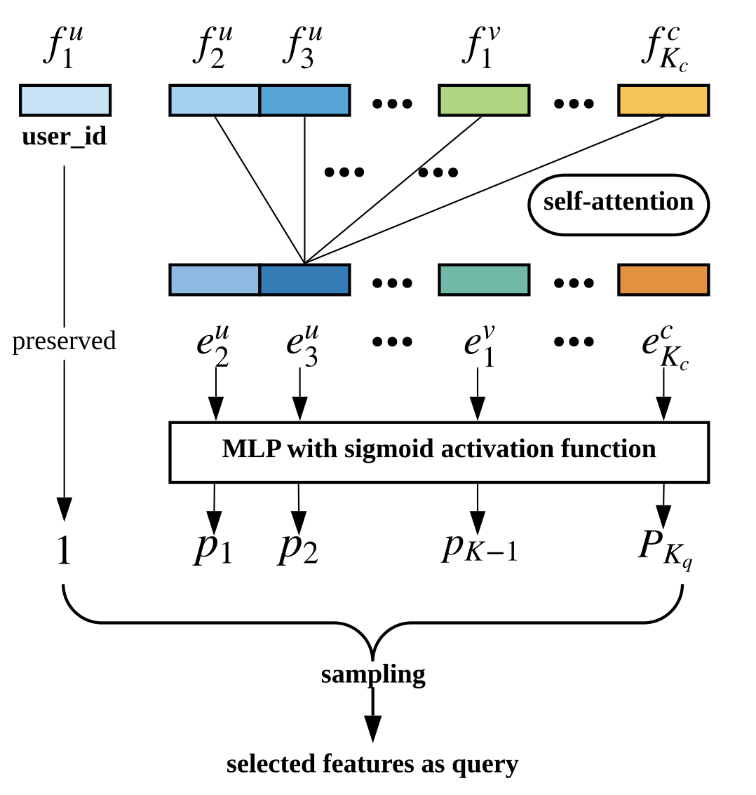
User Behavior Retrieval for CTR Prediction
User behavior retrieval module:
Feature selection model using self-attention:
J. Qin et al. User Behavior Retrieval for Click-Through Rate Prediction. In SIGIR ’20, 2020.

Slide 25
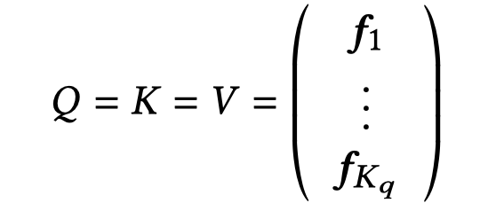
User Behavior Retrieval for CTR Prediction
User behavior retrieval module:
Feature selection model using self-attention:
J. Qin et al. User Behavior Retrieval for Click-Through Rate Prediction. In SIGIR ’20, 2020.

Slide 26
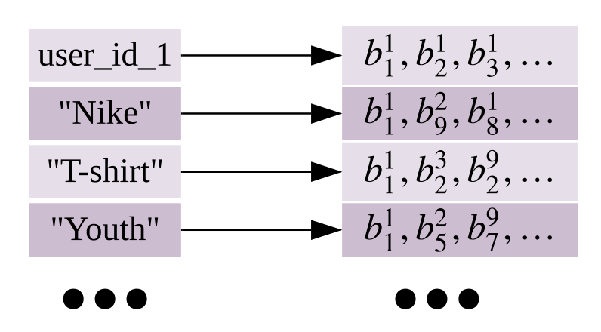
User Behavior Retrieval for CTR Prediction
User behavior retrieval module:
Behavior searching:
Behavior storage: feature based inverted index
The query is formulated as
J. Qin et al. User Behavior Retrieval for Click-Through Rate Prediction. In SIGIR ’20, 2020.

Slide 27
User Behavior Retrieval for CTR Prediction
User behavior retrieval module:
Behavior searching:
Use BM25 to score every behavior document
J. Qin et al. User Behavior Retrieval for Click-Through Rate Prediction. In SIGIR ’20, 2020.

Slide 28
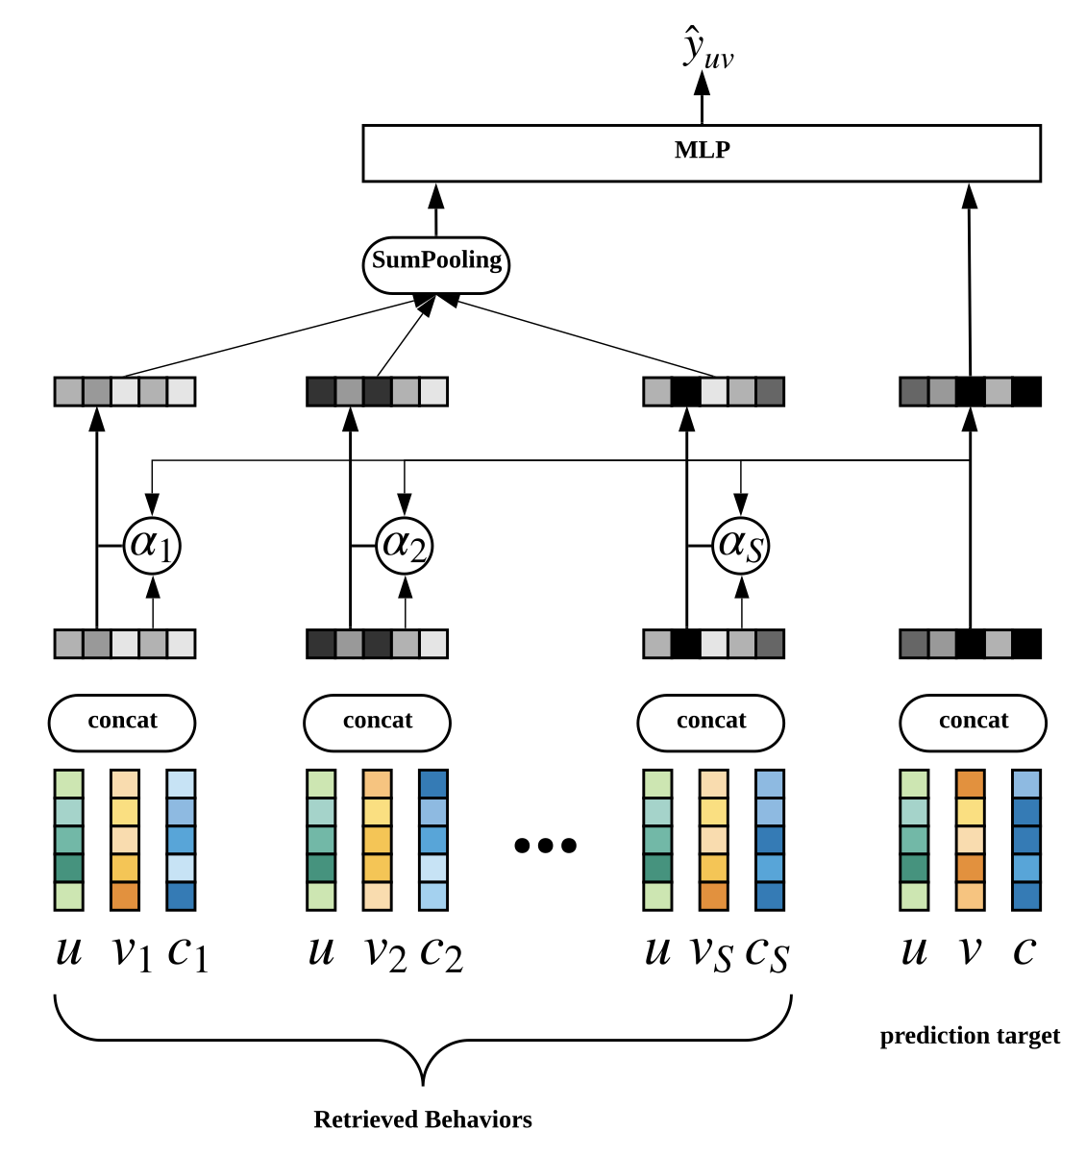
User Behavior Retrieval for CTR Prediction
Prediction module:
J. Qin et al. User Behavior Retrieval for Click-Through Rate Prediction. In SIGIR ’20, 2020.

Slide 29
User Behavior Retrieval for CTR Prediction
Model training:
Objective function:
Optimize the prediction model:
J. Qin et al. User Behavior Retrieval for Click-Through Rate Prediction. In SIGIR ’20, 2020.

Slide 30
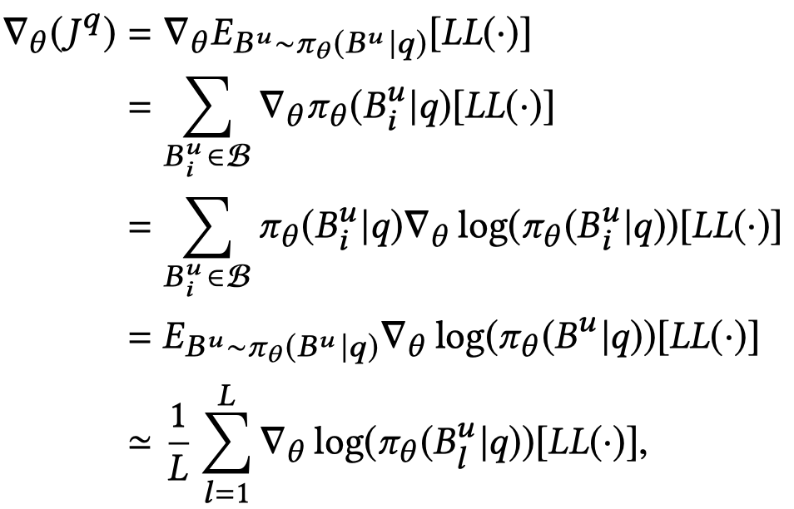
User Behavior Retrieval for CTR Prediction
Model training:
As the retrieval operation is discrete so we use policy gradient to estimate the gradient of that operation
Optimize the retrieval module:
J. Qin et al. User Behavior Retrieval for Click-Through Rate Prediction. In SIGIR ’20, 2020.

Slide 31
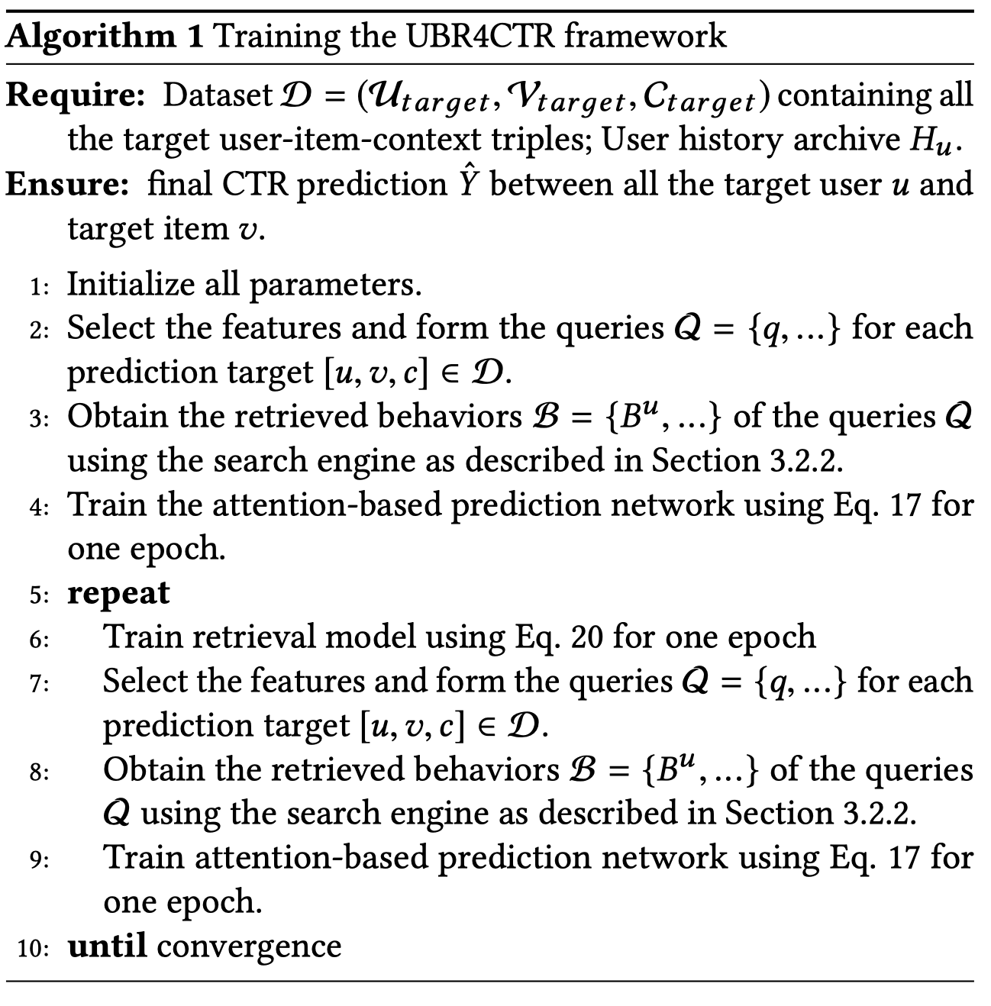
User Behavior Retrieval for CTR Prediction
Model training:
J. Qin et al. User Behavior Retrieval for Click-Through Rate Prediction. In SIGIR ’20, 2020.

Slide 32
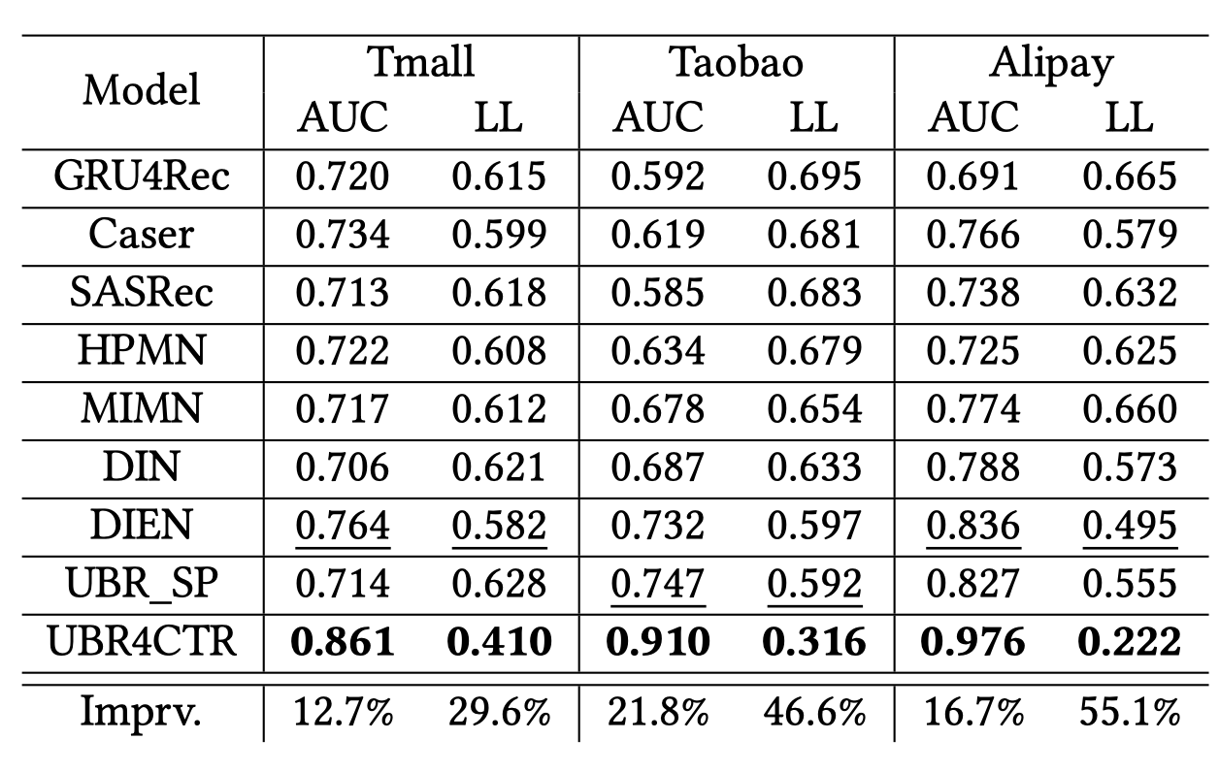
User Behavior Retrieval for CTR Prediction
Experimental results:
Group1: Same length of user sequences
J. Qin et al. User Behavior Retrieval for Click-Through Rate Prediction. In SIGIR ’20, 2020.

Slide 33
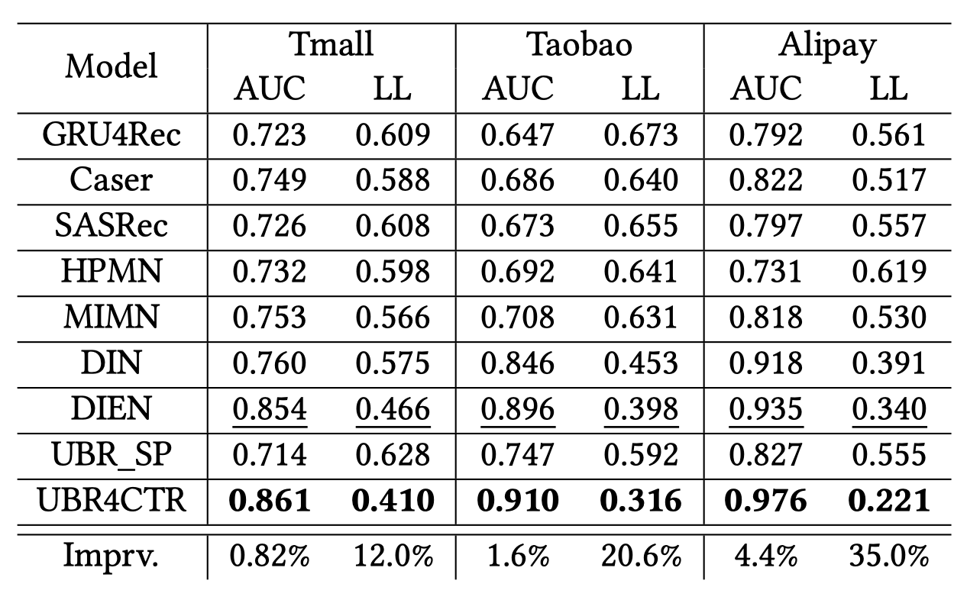
User Behavior Retrieval for CTR Prediction
Experimental results:
Group2: Longer length for baselines
J. Qin et al. User Behavior Retrieval for Click-Through Rate Prediction. In SIGIR ’20, 2020.

Slide 34
User Behavior Retrieval for CTR Prediction
Experimental results:
Ablation study:
J. Qin et al. User Behavior Retrieval for Click-Through Rate Prediction. In SIGIR ’20, 2020.

Slide 35
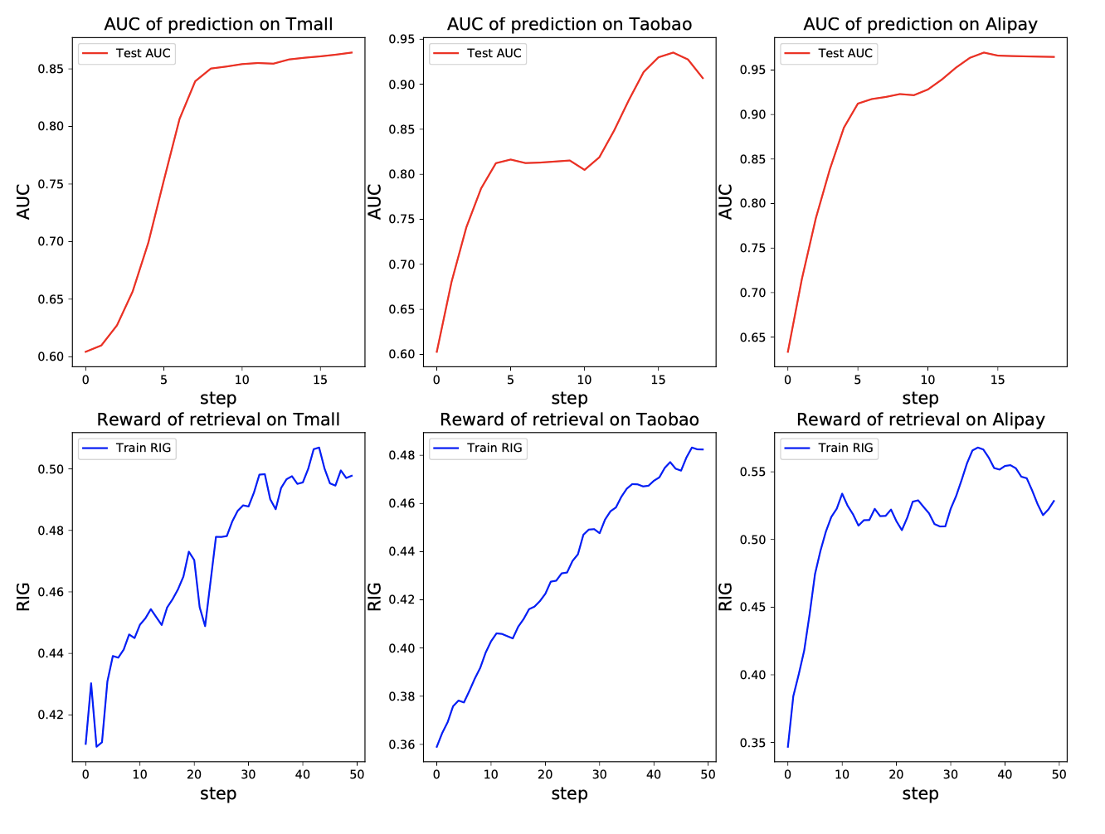
User Behavior Retrieval for CTR Prediction
Experimental results:
Learning process:
J. Qin et al. User Behavior Retrieval for Click-Through Rate Prediction. In SIGIR ’20, 2020.

Slide 36
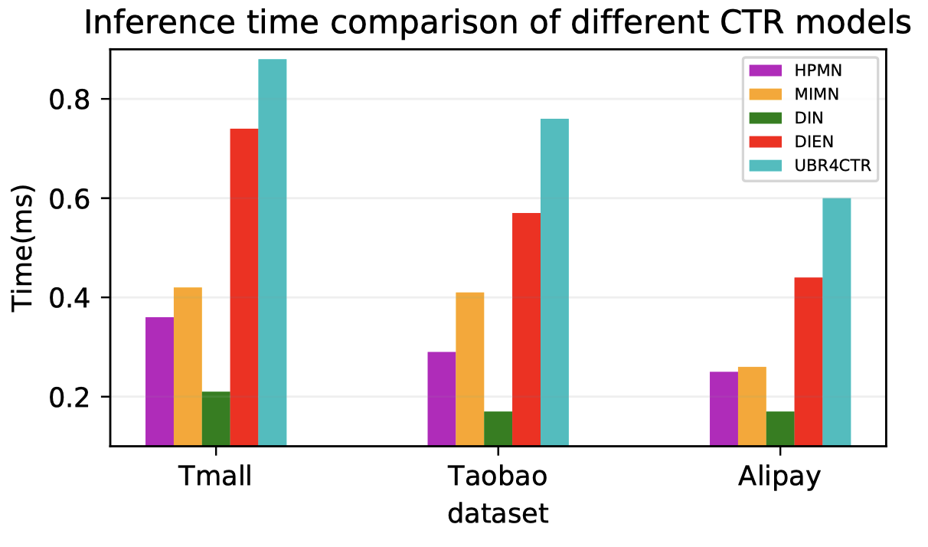
User Behavior Retrieval for CTR Prediction
Experimental results:
Deployment feasibility:
J. Qin et al. User Behavior Retrieval for Click-Through Rate Prediction. In SIGIR ’20, 2020.

